Slide 1
Trie (Prefix Tree)
By Group 12

Slide 2
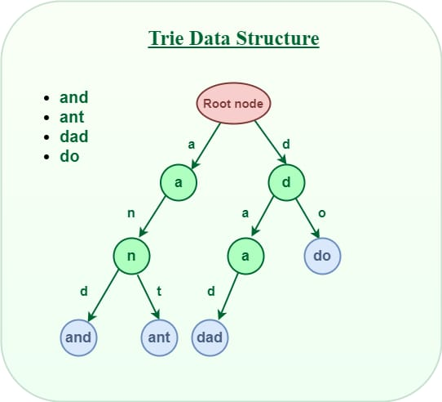
A tree-like data structure used to store strings efficiently by sharing common prefixes. It consists of nodes connected by edges. Each node represents a character or a part of a string. The root node (starting point of the Trie) represents an empty string. Each edge emanating from a node signifies a specific character. The path from the root to a node represents the prefix of a string stored in the Trie.
Operations like insertion, search and deletion are performed in O(n), where n is the length of the word.

Slide 3
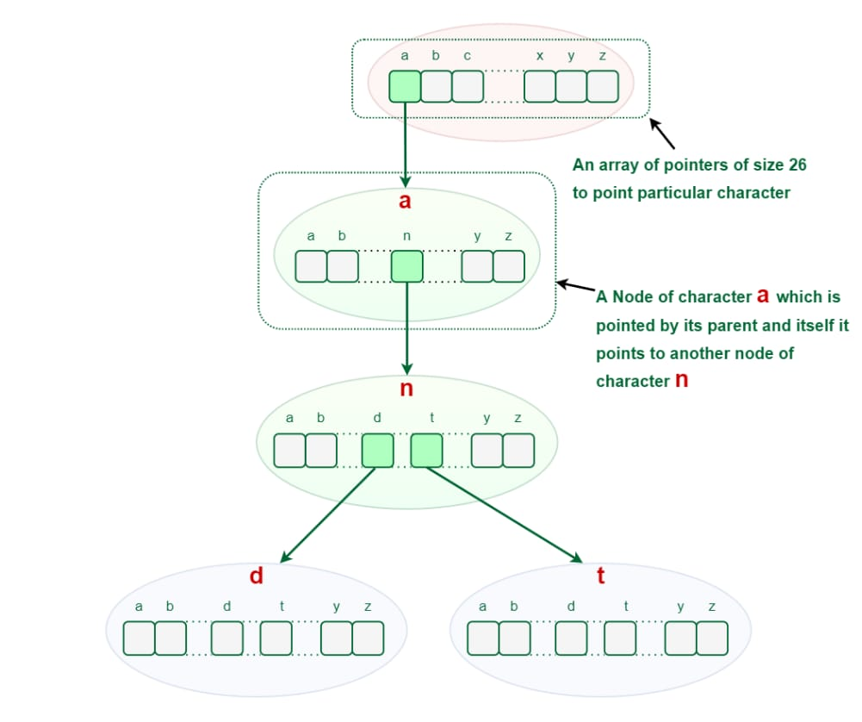
Insert (Key): Adds a word into the trie.
Start at root node: It has no character associated with it and its wordEnd value is 0, indicating no complete word ends at this point.
“a”: Calculate index using ‘a’ – ‘a’ = 0. Check if child[0] is null. Since it is, create new TrieNode with the character “a“, wordEnd set to 0 and an empty array of pointers. Move to this new node.
“n”: Calculate index using ‘n’ – ‘a’ = 13. Check if child[13] is null. It is, so create new TrieNode with the character “n“, wordEnd set to 0 and an empty array of pointers. Move to this new node.
“d”: Calculate the index using ‘d’ – ‘a’ = 3. Check if child[3] is null. It is, so create new TrieNode with the character “d“, wordEnd set to 1 (indicating the word “and” ends here).

Slide 4
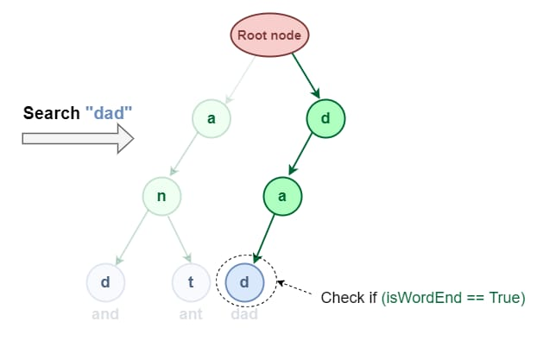
Search (Key): Checks if a word exists in the trie.
Start at root node. This is the starting point for all searches within the Trie.
Traverse the Trie based on the characters of the word you are searching for. For each character, follow the corresponding branch. If the branch doesn’t exist, the word is not present in the Trie.
If you reach the end of the word and the wordEnd flag is set to 1, the word has been found.
If you reach the end of the word and the wordEnd flag is 0, the word is not present in the Trie, even though it shares a prefix with an existing word.

Slide 5
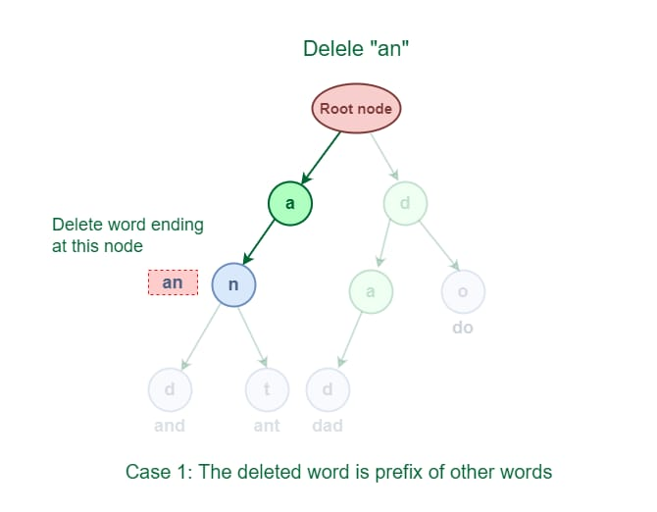
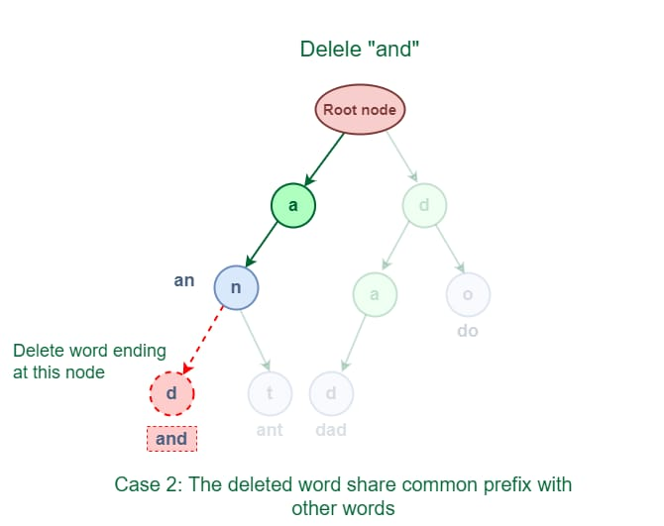
Delete (Key): Removes a word from the trie if it exists.
Deleted word is a prefix of other words: An easy solution to perform a delete operation for this case is to just decrement the wordCount by 1 at the ending node of the word.
Deleted word shares a common prefix with other words: The solution for this case is to delete all the nodes starting from the end of the prefix to the last character of the given word.

Slide 6
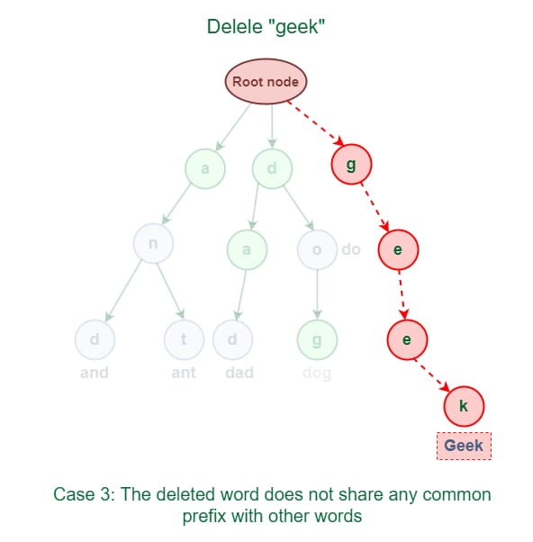
The deleted word does not share any common prefix with other words.
As shown in the following figure, the word “geek” does not share any common prefix with any other words.
The solution for this case is just to delete all the nodes.

Slide 7
Properties:
Each Trie has an empty root node, with links (or references) to other nodes
Each node of a Trie represents a string and each edge represents a character.
Every node consists of hashmaps or an array of pointers, with each index representing a character and a flag to indicate if any string ends at the current node.
It can contain any number of characters including alphabets, numbers and special characters.
Each path from the root to any node represents a word or string.
Case-sensitive or case-insensitive depending on the implementation.

Slide 8
Application Domain That Suits Trie: Autocomplete Systems
Tries are widely used in search engines or text editors for implementing autocompletion. Example: As a user types a query, the system suggests possible completions based on stored words.

Slide 9
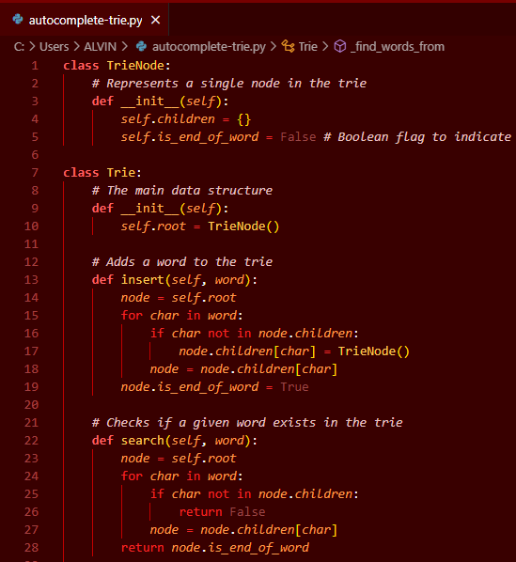
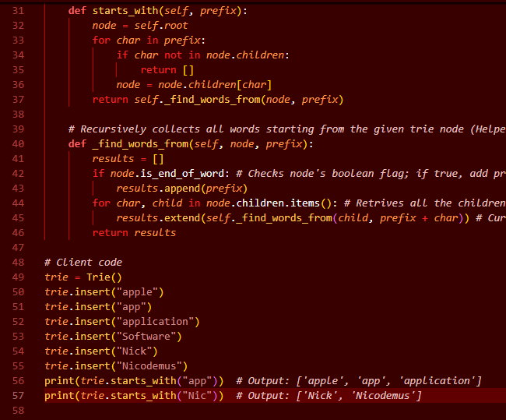
Python Implementation for Autocomplete:

